Slide 1
How to predict the radiative efficiency of greenhouse gases
Min-ho Ku

Slide 2
Why choosing this topic
The combination of the major now and the past
The topic is about global warming

Slide 3
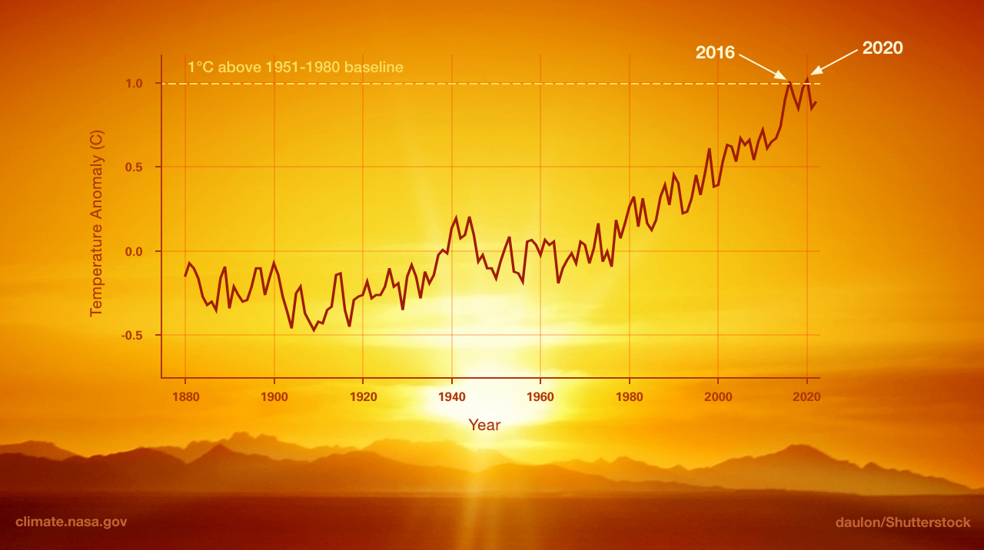
Global warming
The rising average temperature of Earth
The cause - Green house gases (GHGs)
NASA. "What Is Climate Change?" NASA Science, https://science.nasa.gov/climate-change/what-is-climate-change/. Accessed October 6, 2024.

Slide 4
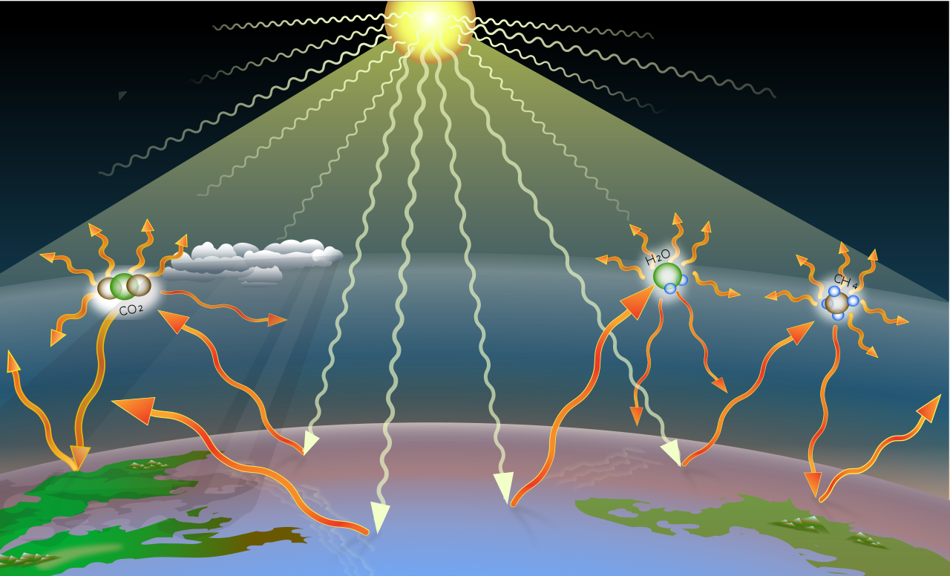
How to measure the effects of the GHGs
Radiative efficiency or radiative forcing (Wikipedia, 2024)
Definition: The change of flux (Unit: W/m^2)

Slide 5
How to calculate radiative efficiency
By experience (Wiki,2024)
using quantum mechanic algorithm (Balaganesh Muthiah, 2024)
using a machine learning (Balaganesh Muthiah, 2024)

Slide 6

How to calculate radiative efficiency (RE)
By experience (Wiki,2024)
Ex. The Formula use on CO₂

Slide 7
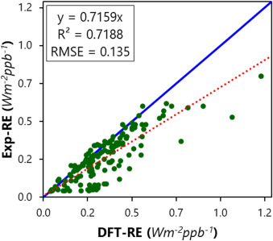
How to calculate radiative efficiency (RE)
Using quantum mechanic algorithm (Balaganesh Muthiah, 2024)
Use Q-CHEM software for Density Function Theory calculation of RE

Slide 8
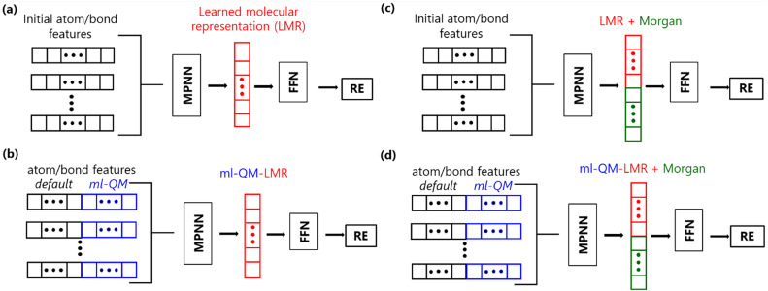
How to calculate radiative efficiency (RE)
using a machine learning (Balaganesh Muthiah, 2024)

Slide 9
Reference
Muthiah, B., Li, S.-C., Li, Y.-P., 2023. Developing machine learning models for accurate prediction of radiative efficiency of greenhouse gases. J. Taiwan Inst. Chem. Eng. 151, 105123.
Wikipedia contributors. (2024, October 6). Radiative forcing. Wikipedia. https://en.wikipedia.org/wiki/Radiative_forcing

